Slide 1
Memory Management
Operating Systems: Internals and Design Principles
Notes:
“Operating Systems: Internal and Design Principles”, 7/e, by William Stallings, Chapter 7 “Memory Management”.

Slide 2

Operating Systems: Internals and Design Principles
I cannot guarantee that I carry all the facts in my mind. Intense mental concentration has a curious way of blotting out what has passed. Each of my cases displaces the last, and Mlle. Carère has blurred my
recollection of Baskerville Hall. Tomorrow some other little problem may be submitted to my notice which will in turn dispossess the fair French lady and the infamous Upwood.
— THE HOUND OF THE BASKERVILLES,
Arthur Conan Doyle
Notes:
In a uniprogramming system, main memory is divided into two parts: one part for the operating system (resident monitor, kernel) and one part for the program currently being executed. In a multiprogramming system, the “user” part of memory must be further subdivided to accommodate multiple processes. The task of subdivision is carried out dynamically by the operating system and is known as memory management .
Effective memory management is vital in a multiprogramming system. If only a few processes are in memory, then for much of the time all of the processes will be waiting for I/O and the processor will be idle. Thus memory needs to be allocated to ensure a reasonable supply of ready processes to consume available processor time.
We begin this chapter with a look at the requirements that memory management is intended to satisfy. Next, we approach the technology of memory management by looking at a variety of simple schemes that have been used. Our focus is the requirement that a program must be loaded into main memory to be executed. This discussion introduces some of the fundamental principles of memory management.

Slide 3
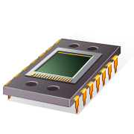
Memory Management Requirements
Memory management is intended to satisfy the following requirements:
Relocation
Protection
Sharing
Logical organization
Physical organization
Notes:
While surveying the various mechanisms and policies associated with memory management, it is helpful to keep in mind the requirements that memory management is intended to satisfy. These requirements include the following:
• Relocation
• Protection
• Sharing
• Logical organization
• Physical organization

Slide 4
Relocation
Programmers typically do not know in advance which other programs will be resident in main memory at the time of execution of their program
Active processes need to be able to be swapped in and out of main memory in order to maximize processor utilization
Specifying that a process must be placed in the same memory region when it is swapped back in would be limiting
may need to relocate the process to a different area of memory
Notes:
In a multiprogramming system, the available main memory is generally shared among a number of processes. Typically, it is not possible for the programmer to know in advance which other programs will be resident in main memory at the time of execution of his or her program. In addition, we would like to be able to swap active processes in and out of main memory to maximize processor utilization by providing a large pool of ready processes to execute. Once a program is swapped out to disk, it would be quite limiting to specify that when it is next swapped back in, it must be placed in the same main memory region as before. Instead, we may need to relocate the process to a different area of memory.

Slide 5
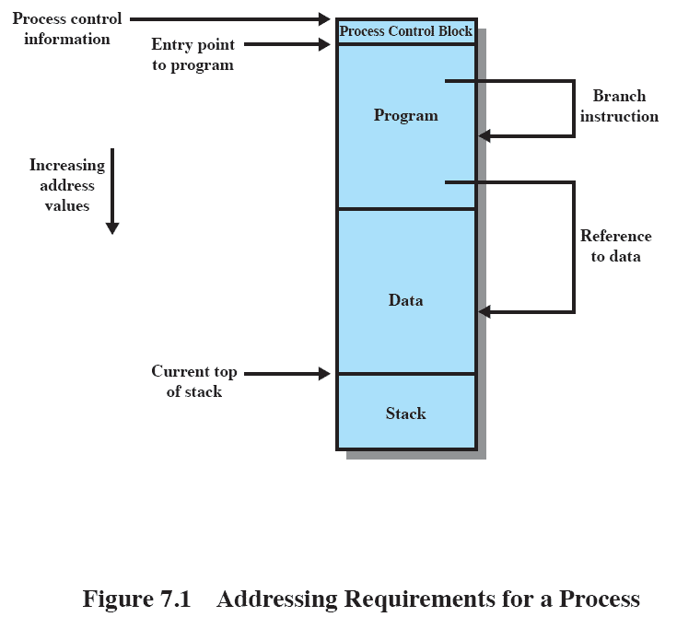
Addressing Requirements
Notes:
Thus, we cannot know ahead of time where a program will be placed, and we must allow for the possibility that the program may be moved about in main memory due to swapping. These facts raise some technical concerns related to addressing, as illustrated in Figure 7.1 . The figure depicts a process image. For simplicity, let us assume that the process image occupies a contiguous region of main memory. Clearly, the operating system will need to know the location of process control information and of the execution stack, as well as the entry point to begin execution of the program for this process. Because the operating system is managing memory and is responsible for bringing this process into main memory, these addresses are easy to come by. In addition, however, the processor must deal with memory references within the program. Branch instructions contain an address to reference
the instruction to be executed next. Data reference instructions contain the address of the byte or word of data referenced. Somehow, the processor hardware and operating system software must be able to translate the memory references found in the code of the program into actual physical memory addresses, reflecting the current location of the program in main memory.

Slide 6

Protection
Processes need to acquire permission to reference memory locations for reading or writing purposes
Location of a program in main memory is unpredictable
Memory references generated by a process must be checked at run time
Mechanisms that support relocation also support protection
Notes:
Each process should be protected against unwanted interference by other processes, whether accidental or intentional. Thus, programs in other processes should not be able to reference memory locations in a process for reading or writing purposes without permission. In one sense, satisfaction of the relocation requirement increases the difficulty of satisfying the protection requirement. Because the location of a program in main memory is unpredictable, it is impossible to check absolute addresses at compile time to assure protection. Furthermore, most programming languages allow the dynamic calculation of addresses at run time (e.g., by computing an array subscript or a pointer into a data structure). Hence all
memory references generated by a process must be checked at run time to ensure that they refer only to the memory space allocated to that process. Fortunately, we shall see that mechanisms that support relocation also support the protection requirement.
Normally, a user process cannot access any portion of the operating system, neither program nor data. Again, usually a program in one process cannot branch to an instruction in another process. Without special arrangement, a program in one process cannot access the data area of another process. The processor must be able to abort such instructions at the point of execution.
Note that the memory protection requirement must be satisfied by the processor (hardware) rather than the operating system (software). This is because the OS cannot anticipate all of the memory references that a program will make. Even if such anticipation were possible, it would be prohibitively time consuming to screen each program in advance for possible memory-reference violations. Thus, it is only possible to assess the permissibility of a memory reference (data access or branch) at the time of execution of the instruction making the reference. To accomplish this, the processor hardware must have that capability.

Slide 7

Sharing
Advantageous to allow each process access to the same copy of the program rather than have their own separate copy
Memory management must allow controlled access to shared areas of memory without compromising protection
Mechanisms used to support relocation support sharing capabilities
Notes:
Any protection mechanism must have the flexibility to allow several processes to access the same portion of main memory. For example, if a number of processes are executing the same program, it is advantageous to allow each process to access the same copy of the program rather than have its own separate copy. Processes that are cooperating on some task may need to share access to the same data structure. The memory management system must therefore allow controlled access to shared areas of memory without compromising essential protection. Again, we will see that the mechanisms used to support relocation support sharing capabilities.

Slide 8
Logical Organization
Memory is organized as linear
Segmentation is the tool that most readily satisfies requirements
Programs are written in modules
modules can be written and compiled independently
different degrees of protection given to modules (read-only, execute-only)
sharing on a module level corresponds to the user’s way of viewing the problem
Notes:
Almost invariably, main memory in a computer system is organized as a linear, or one-dimensional, address space, consisting of a sequence of bytes or words. Secondary memory, at its physical level, is similarly organized. While this organization closely mirrors the actual machine hardware, it does not correspond to the way in which programs are typically constructed. Most programs are organized into modules, some of which are unmodifiable (read only, execute only) and some of which contain data that may be modified. If the operating system and computer hardware can effectively deal with user programs and data in the form of modules of some sort, then a number of advantages can be realized:
1. Modules can be written and compiled independently, with all references from
one module to another resolved by the system at run time.
2. With modest additional overhead, different degrees of protection (read only,
execute only) can be given to different modules.
3. It is possible to introduce mechanisms by which modules can be shared among
processes. The advantage of providing sharing on a module level is that this corresponds to the user’s way of viewing the problem, and hence it is easy for
the user to specify the sharing that is desired. The tool that most readily satisfies these requirements is segmentation, which is one of the memory management techniques explored in this chapter.

Slide 9
Physical Organization
Cannot leave the programmer with the responsibility to manage memory
Memory available for a program plus its data may be insufficient
overlaying allows various modules to be assigned the same region of memory but is time consuming to program
Programmer does not know how much space will be available
Notes:
As we discussed in Section 1.5 , computer memory is organized into at least two levels, referred to as main memory and secondary memory. Main memory provides fast access at relatively high cost. In addition, main memory is volatile; that is, it does not provide permanent storage. Secondary memory is slower and cheaper than
main memory and is usually not volatile. Thus secondary memory of large capacity can be provided for long-term storage of programs and data, while a smaller main memory holds programs and data currently in use. In this two-level scheme, the organization of the flow of information between main and secondary memory is a major system concern. The responsibility for this flow could be assigned to the individual programmer, but this is impractical and undesirable for two reasons:
1. The main memory available for a program plus its data may be insufficient. In
that case, the programmer must engage in a practice known as overlaying , in which the program and data are organized in such a way that various modules can be assigned the same region of memory, with a main program responsible for switching the modules in and out as needed. Even with the aid of compiler tools, overlay programming wastes programmer time.
2. In a multiprogramming environment, the programmer does not know at the time of coding how much space will be available or where that space will be. It is clear, then, that the task of moving information between the two levels of memory should be a system responsibility. This task is the essence of memory management.

Slide 10
Memory Partitioning
Memory management brings processes into main memory for execution by the processor
involves virtual memory
based on segmentation and paging
Partitioning
used in several variations in some now-obsolete operating systems
does not involve virtual memory
Notes:
The principal operation of memory management is to bring processes into main memory for execution by the processor. In almost all modern multiprogramming systems, this involves a sophisticated scheme known as virtual memory. Virtual memory is, in turn, based on the use of one or both of two basic techniques: segmentation and paging. Before we can look at these virtual memory techniques, we must prepare the ground by looking at simpler techniques that do not involve virtual memory ( Table 7.2 summarizes all the techniques examined in this chapter and the next). One of these techniques, partitioning, has been used in several variations in some now-obsolete operating systems. The other two techniques, simple paging and simple segmentation, are not used by themselves. However, it will clarify the discussion of virtual memory if we look first at these two techniques in the absence of virtual memory considerations.

Slide 11
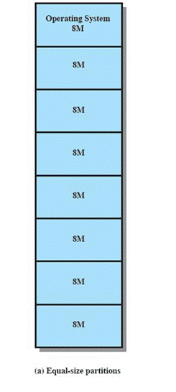
Fixed Partitioning
Equal-size partitions
any process whose size is less than or equal to the partition size can be loaded into an available partition
The operating system can swap out a process if all partitions are full and no process is in the Ready or Running state
Notes:
In most schemes for memory management, we can assume that the OS occupies some fixed portion of main memory and that the rest of main memory is available for use by multiple processes. The simplest scheme for managing this available memory is to partition it into regions with fixed boundaries.
PARTITION SIZES Figure 7.2 shows examples of two alternatives for fixed partitioning. One possibility is to make use of equal-size partitions. In this case, any process whose size is less than or equal to the partition size can be loaded into any available partition. If all partitions are full and no process is in the Ready or Running state, the operating system can swap a process out of any of the partitions and load in another process, so that there is some work for the processor.

Slide 12
Disadvantages
A program may be too big to fit in a partition
program needs to be designed with the use of overlays
Main memory utilization is inefficient
any program, regardless of size, occupies an entire partition
internal fragmentation
wasted space due to the block of data loaded being smaller than the partition
Notes:
There are two difficulties with the use of equal-size fixed partitions:
• A program may be too big to fit into a partition. In this case, the programmer must design the program with the use of overlays so that only a portion of the program need be in main memory at any one time. When a module is needed that is not present, the user’s program must load that module into the program’s partition, overlaying whatever programs or data are there.
• Main memory utilization is extremely inefficient. Any program, no matter how small, occupies an entire partition. In our example, there may be a program whose length is less than 2 Mbytes; yet it occupies an 8-Mbyte partition whenever it is swapped in. This phenomenon, in which there is wasted space internal to a partition due to the fact that the block of data loaded is smaller than the partition, is referred to as internal fragmentation .

Slide 13
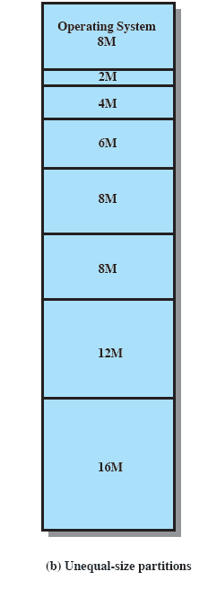
Unequal Size Partitions
Using unequal size partitions helps lessen the problems
programs up to 16M can be accommodated without overlays
partitions smaller than 8M allow smaller programs to be accommodated with less internal fragmentation
Notes:
Both of these problems can be lessened, though not solved, by using unequal size partitions ( Figure 7.2b ). In this example, programs as large as 16 Mbytes can be accommodated without overlays. Partitions smaller than 8 Mbytes allow smaller programs to be accommodated with less internal fragmentation.

Slide 14

Disadvantages
The number of partitions specified at system generation time limits the number of active processes in the system
Small jobs will not utilize partition space efficiently
Notes:
The use of unequal-size partitions provides a degree of flexibility to fixed partitioning. In addition, it can be said that fixed-partitioning schemes are relatively simple and require minimal OS software and processing overhead. However, there are disadvantages:
• The number of partitions specified at system generation time limits the number of active (not suspended) processes in the system.
• Because partition sizes are preset at system generation time, small jobs will not utilize partition space efficiently. In an environment where the main storage requirement of all jobs is known beforehand, this may be reasonable, but in most cases, it is an inefficient technique.

Slide 15
Dynamic Partitioning
Partitions are of variable length and number
Process is allocated exactly as much memory as it requires
This technique was used by IBM’s mainframe operating system, OS/MVT
Notes:
To overcome some of the difficulties with fixed partitioning, an approach known as dynamic partitioning was developed. Again, this approach has been supplanted by more sophisticated memory management techniques. An important operating system that used this technique was IBM’s mainframe operating system, OS/MVT (Multiprogramming with a Variable Number of Tasks).
With dynamic partitioning, the partitions are of variable length and number. When a process is brought into main memory, it is allocated exactly as much memory as it requires and no more.

Slide 16
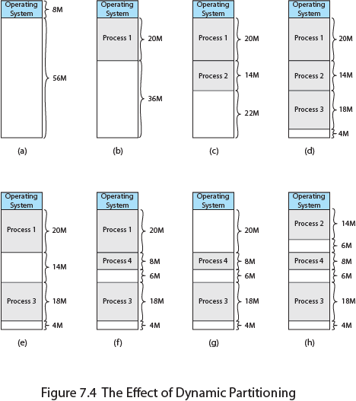
Effect of Dynamic Partitioning
Notes:
An example, using 64 Mbytes of main memory, is shown in Figure 7.4 . Initially, main memory is empty, except for the OS (a). The first three processes are loaded in, starting where the operating system ends and occupying just enough space for each process (b, c, d). This leaves a “hole” at the end of memory that is too small for a fourth process. At some point, none of
the processes in memory is ready. The operating system swaps out process 2 (e), which leaves sufficient room to load a new process, process 4 (f). Because process 4 is smaller than process 2, another small hole is created. Later, a point is reached at which none of the processes in main memory is ready, but process 2, in the Ready-Suspend state, is available. Because there is insufficient room in memory for process 2, the operating system swaps process 1 out (g) and swaps process 2 back in (h).
As this example shows, this method starts out well, but eventually it leads to a situation in which there are a lot of small holes in memory. As time goes on, memory becomes more and more fragmented, and memory utilization declines. This phenomenon is referred to as external fragmentation , indicating that the memory that is external to all partitions becomes increasingly fragmented. This is in contrast to internal fragmentation, referred to earlier.

Slide 17
Dynamic Partitioning
External Fragmentation
memory becomes more and more fragmented
memory utilization declines
Compaction
technique for overcoming external fragmentation
OS shifts processes so that they are contiguous
free memory is together in one block
time consuming and wastes CPU time
Notes:
One technique for overcoming external fragmentation is compaction : From time to time, the OS shifts the processes so that they are contiguous and so that all of the free memory is together in one block. For example, in Figure 7.4h , compaction will result in a block of free memory of length 16M. This may well be sufficient to load in an additional process. The difficulty with compaction is that it is a time-consuming procedure and wasteful of processor time. Note that compaction implies the need for a dynamic relocation capability. That is, it must be possible to move a program from one region to another in main memory without invalidating the memory references in the program (see Appendix 7A).

Slide 18
Placement Algorithms
Best-fit
chooses the block that is closest in size to the request
First-fit
begins to scan memory from the beginning and chooses the first available block that is large enough
Next-fit
begins to scan memory from the location of the last placement and chooses the next available block that is large enough
Notes:
PLACEMENT ALGORITHM Because memory compaction is time consuming, the OS designer must be clever in deciding how to assign processes to memory (how to plug the holes). When it is time to load or swap a process into main memory, and if there is more than one free block of memory of sufficient size, then the operating system must decide which free block to allocate.
Three placement algorithms that might be considered are best-fit, first-fit, and next-fit. All, of course, are limited to choosing among free blocks of main memory that are equal to or larger than the process to be brought in. Best-fit chooses the block that is closest in size to the request. First-fit begins to scan memory from the beginning and chooses the first available block that is large enough. Next-fit begins to scan memory from the location of the last placement, and chooses the next available block that is large enough.

